Slide 1
Physical computing from Scratch using scratchClient – Beginners Control servos, LEDs and more from Scratch using RPi, Arduino, scratchClient
Hans de Jong & Gerhard Hepp
Pi And More 10
Krefeld – 24 June 2017

Slide 2
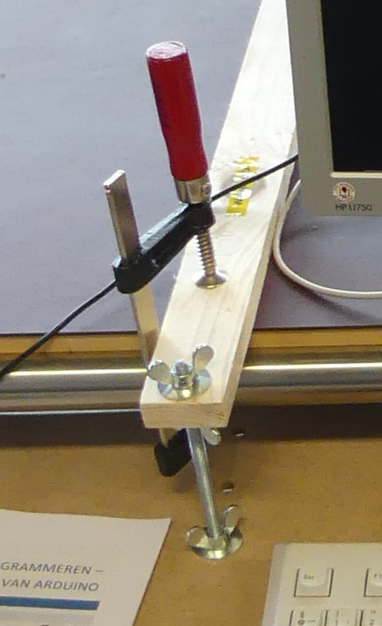
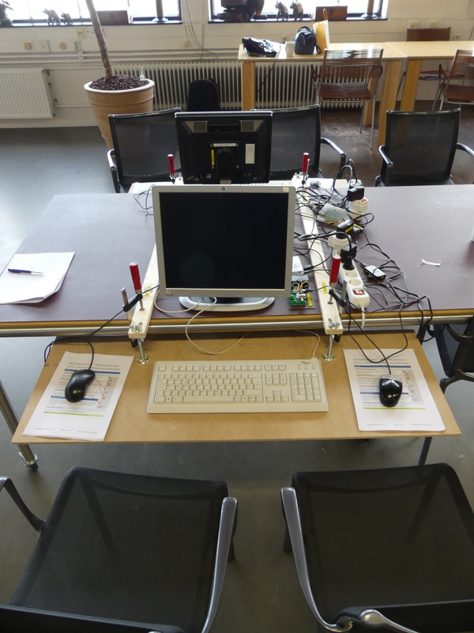
Ergonomics
At the Weekendschool we teach children 5 golden rules how to sit when using computers:
Rest your arms on the table in a natural fashion.
If you do not need the keyboard, move it up and give room to the mouse.
Have the monitor at arms length.
Change position (lean forward, backward etc.).
Frequently stop, walk around and exercise.
To change the height, use the two upper wingnuts.

Slide 3
Workshop organisation
Welcome and introduction presentation (10 min).
After that everyone will work at his or her own pace.
At times we will present for 5 minutes to explain a next concept.
Language: English, but help in German available.
At the end copy the material to your USB stick (if you want)
Cleanup.
The major steps:
Get a working hardware and scratchClient config using a Scratch test program.
Update scratchClient config (moving to other GPIO pins)
Write your own Scratch program to access the board.
Add more hardware (buzzer, tri-color LED, button, joy stick) and adapt scratchClient config and adapt the Scratch program.
If you want: have a look at the game used at the Weekendschool and program a bit yourself (but it is still in Dutch ☺ )
Start latest 30 minutes before the end of the workshop.

Slide 4
Objectives
At the end of today you should be able to:
Reproduce the setup at home (provided you have the hardware ☺ )
Understand
Digital output (e.g. lighting a LED)
Digital input (e.g. sensing a button)
Analog input (e.g. from a potentiometer)
Pulse Width Modulation (PWM)
for dimming LEDs
For controlling servos
Understand what all the resistors are for
Be able to configure and run scratchClient
Program Scratch to control the physical input and output
If time permits / as you desire: look at a game using servos, buttons, LEDs etc. as used on the Weekendschools in The Netherlands.
Have fun!

Slide 5
Non-objective
It is not an objective to create a complete useful game or other program.
You can do that with your own creativity at home now that you know how to control several pieces of hardware from Scratch using scratchClient.

Slide 6

Weekendschool
Generally parents tell their children: “Learn for later”. But what is later?
“I want to become an engineer. Do you maybe know an engineer? I would very much like to meet one”
Professionals teach children on Sundays about their job. Large variety of topics.
> 1000 students between 11 and 14 years from underprivileged areas.
Curriculum lasts for 2.5 to 3 years
3500+ volunteers.
Funded by 110+ sponsors (companies, individuals, foundations).
Started in 1998.
It works! Data shows: alumni have better professional prospects, are more self-aware, and feel more connected with society.
EINDHOVEN 58 students
IMC Weekendschool
Trudo Weekendschool

Slide 7
Lessons at the Weekendschool
I personally teach
Mathematics (since 12 years)
Physics (since some 6 years)
Programming (started in 2016)
Electro (started in 2016)
Programming: 3 (2) lessons on 5 (3) Sundays with Scratch, Raspberry Pi and Arduino
Last lesson comprises 2 days but is optional and can be done in a later year.
Lesson 2: Physical computing: https://www.youtube.com/watch?v=Qo1gnXNzhqE

Slide 8
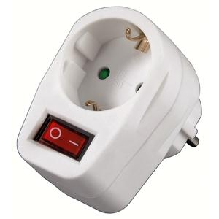
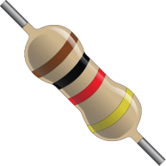
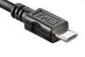

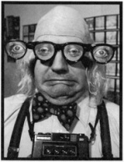
Only a few rules today
If Raspberry Pi needs to be rebooted, it needs a powercycle. Please do not pull plugs but use the switch in the outlet.
Always put a resistor in series with the components
If you think there is no need then please tell us and we will explain what the reason is (with one exception).
When changing the wiring
Stop scratchClient (just close the window)
Detach the USB cable from the Arduino Nano
Switch off the 9V power
Check, double check and check again whether the wiring is correct. You may blow up components when wiring wrongly!
Make sure that you both (4 eyes principle) are convinced the wiring is OK before turning on power again.
If something breaks down or gets damaged: we have some spare material
Do not put anything that is broken back into the box please.

Slide 9
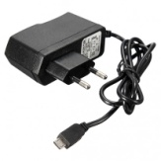
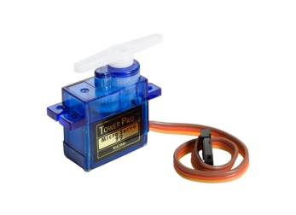
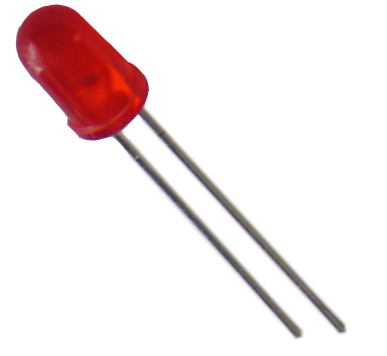
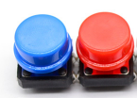


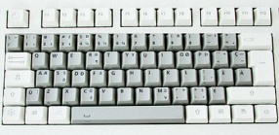
The setup
Raspberry Pi
2B or 3B
Powered USB hub
(Not used when programming the Arduino Nano)
(not strictly needed since Arduino is powered separately – used for protection of RPi)
Arduino Nano
Scratch 1.4 run time
scratchClient
scratchClient Sketch
Remote Sensor Protocol Over socket 42001
Global variables
Broadcasts
Program in Scratch
Predefined sprites (with some code, sounds and costumes)
scratchClient Config file
Defines function of the GPIO pins on the Arduino (and RPi) and gives them logical names.
Standard setup
Programmed by the students
Prepared by the teacher or expert

Slide 10
Where is the presentation?
You will find this presentation = the instruction at your desktop in PiAndMore/Part-1--Breadboard
If you already know the stuff and get bored then feel free to work on your own
Silently please … ☺

Slide 11
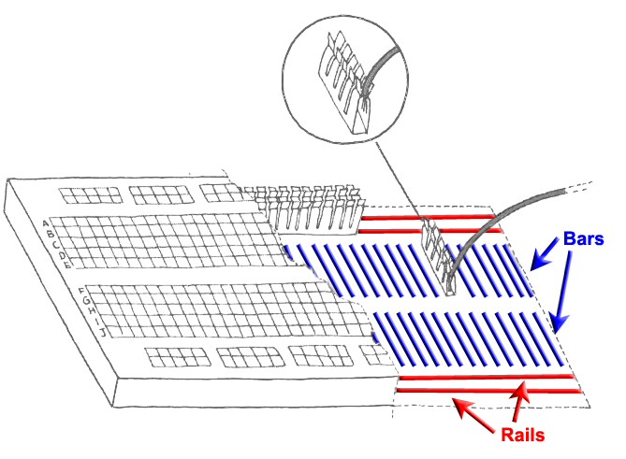
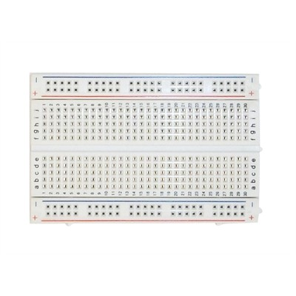
Breadboard
Used to quickly build electronic circuits
Note the 2 rails for + (VCC) and – (GND)
Note the 2 bars with 5 interconnected holes each.

Slide 12
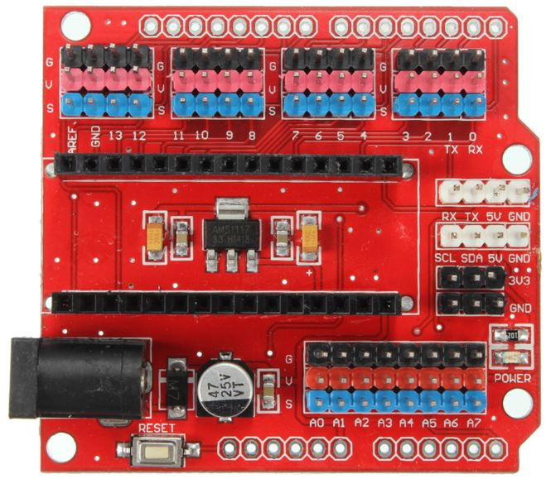
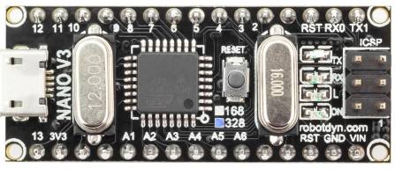
Looking at the Arduino Nano extension board
Analog ports (most can be used as digital ports as well)
Reset button
Per GPIO signal 3 headers:
S (blue = signal)
V (red = VCC = +)
G (black = GND = -)
(very handy to e.g.
connect servos)
9V power socket
Arduino Nano with 328P processor
Micro USB port
Reset button
Digital ports

Slide 13
Preparing for programming the Arduino Nano
Connect the Arduino Nano
Make sure to connect directly
not via the USB hub
for strange reasons it will not work although it used to in previous releases and still should.

Slide 14
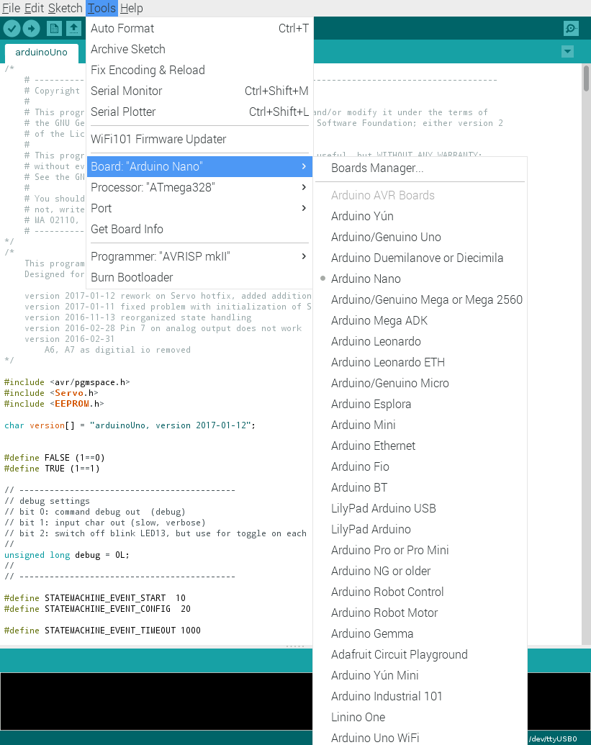
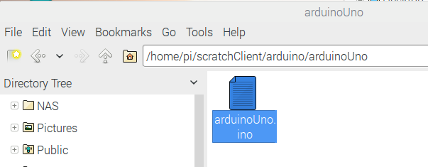
Uploading scratchClient to the Arduino
Make sure that the Arduino is directly connected to the Raspberry Pi (not via the USB hub)
Open the scratchClient sketch for Arduino Uno in /home/pi/scratchClient/arduino/arduinoUno
Double click to open the Arduino IDE
Click Tools and make sure that these are set:
Board: Aruino Nano
Processor Atmega328
Port: the port where the Arduino Nano is connected
Click on the Upload button.
Wait till the completion of the Upload is reported.

Slide 15
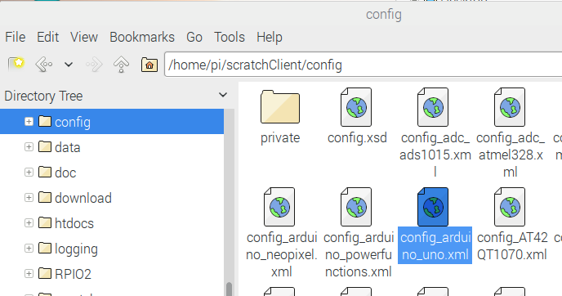
Open the scratchClient config file
/home/pi/scratchClient/config
Note: it is called config_arduino_uno.xml, however it also is for the Nano.

Slide 16
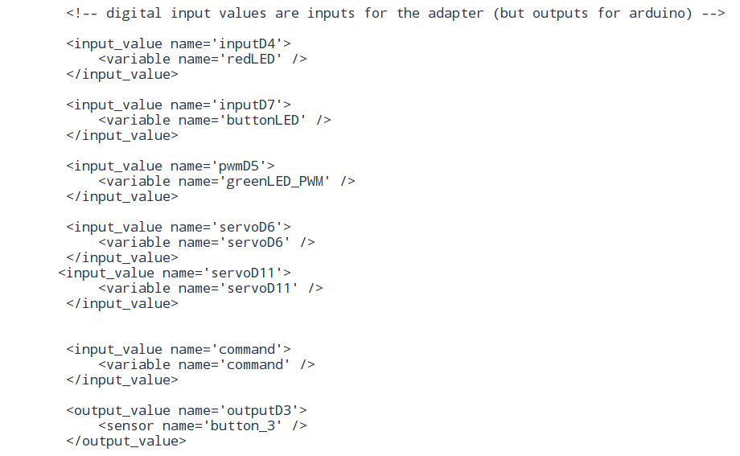
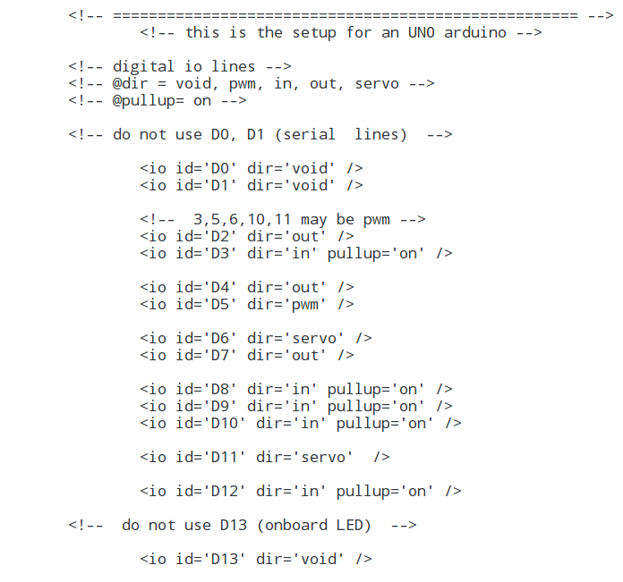
Looking at the scratchClient config file
Note that every definition on the left has a line on the right. Note that the directions are counter intuitive.

Slide 17
Let’s wire the board …
See diagram on the next page
Wire +5V to the + rail at the bottom
Wire GND to the – rail at the bottom
Wire a red LED to pin 4.
Pin 4 → 200 Ohm resistor → GND (minus)
Wire another LED (we use blue) to pin 7.
Pin 7 → 200 Ohm resistor → - (minus) rail
Wire a button to pin 3.
Pin 3 → 1 kOhm resistor → GND (minus)

Slide 18
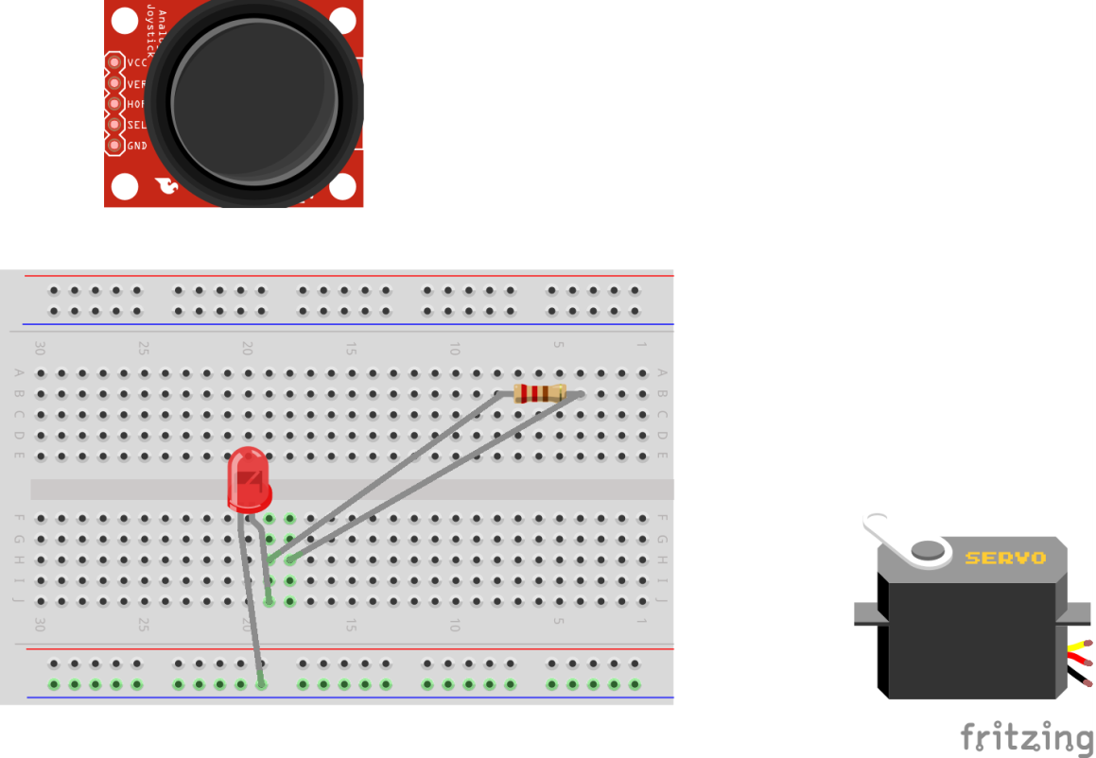
Put the board in front of you in this way

Slide 19
First step: red LED and + and -
200 Ohm resistor – one of the thick ones in the box

Slide 20
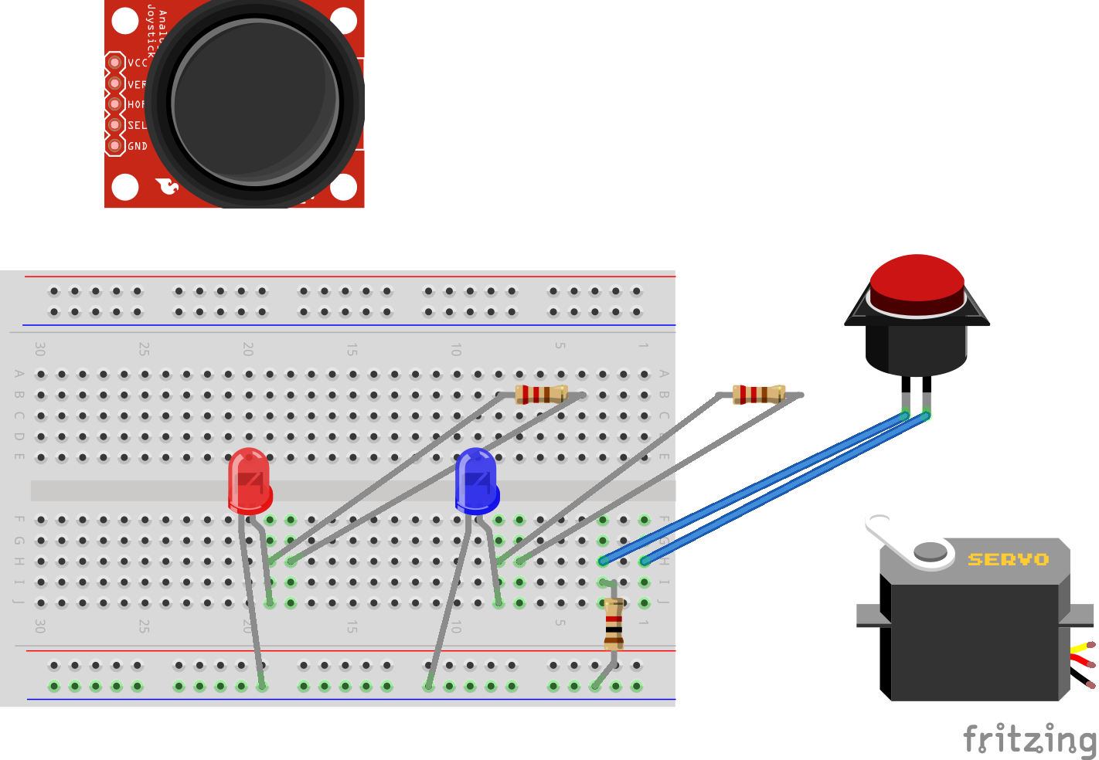
Second step: add button and blue LED
1 kOhm resistor – one of the tiny ones in the box
200 Ohm

Slide 21
Why are these resistors needed?
In series with a LED: to limit the current through the LED
You may blow up the LED and/or the Arduino otherwise.
In series with buttons, potentiometers etc: to avoid blowing up the Arduino in case of config errors
+5 Volt
Consider what would happen if the 1 kOhm resistor were not there and the port would be used as output and the button closed.
Then the Arduino would output 5 Volt, and the switch is directly leading it to the 0 Volt line → short circuit!
Arduino
This is a pull-up resistor that sits in the chip on the Arduino Nano
Digital input
30 kOhm
1 kOhm
0 Volt

Slide 22
Check / double check
Please now check both that the wiring is correct.

Slide 23
Make a script file to start scratchClient
Copy the config file to the desktop.
We will later modify it and want to keep the original.
Then make a new file on the desktop
Call it StartSC_First_Step.bash
Put this in:
!# /bin/bash
sudo python ~/scratchClient/src/scratchClient.py -c ~/Desktop/config_PiAndMore_ttyUSB0.xml
Make the file executable.
Do you understand what the file does?
If not, please ask

Slide 24
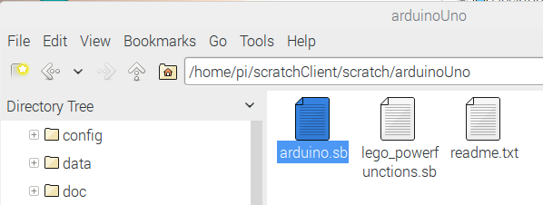
Bringing things together
Connect the 9 Volt connector to the board
Connect the USB connector to the Arduino
Start scratchClient with the script you just made (e.g. double click it and when asked choose Execute in Terminal.
Start the Arduino Scratch test. This is in:
Press the green flag to start the Scratch program.
/home/pi/scratchClient/scratch/arduinoUno

Slide 25
Does it work?

Slide 26
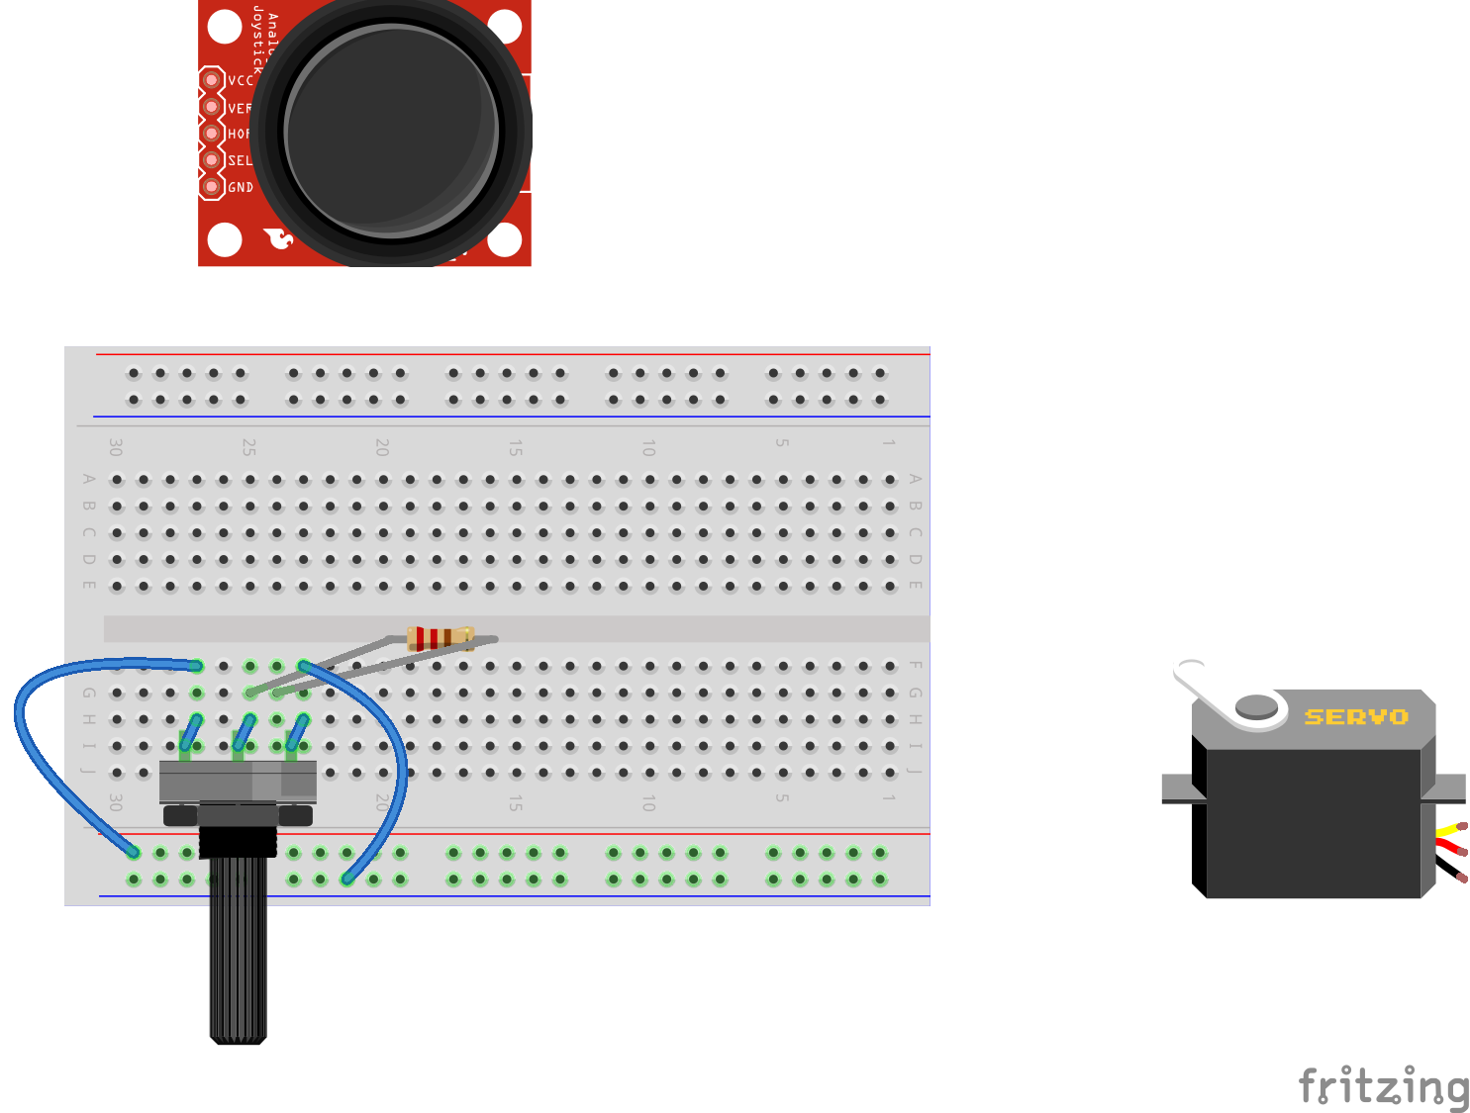
Analog input
Note: only the additional wires are shown.
1 kOhm resistor – one of the tiny ones in the box

Slide 27
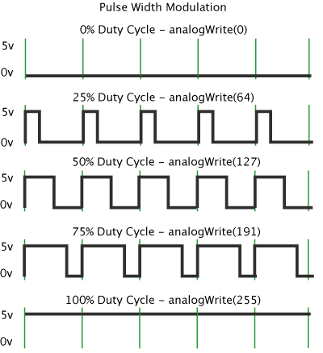
Pulse Width Modulation (PWM)
By modulating (changing) the pulse width, the amount of energy fed to the e.g. LED is changed, and hence the intensity with which you see it lighting.
Note that in practice the LED is blinking some 800 blinks / second.
However, no human eye can see more than 100 blinks / second.

Slide 28
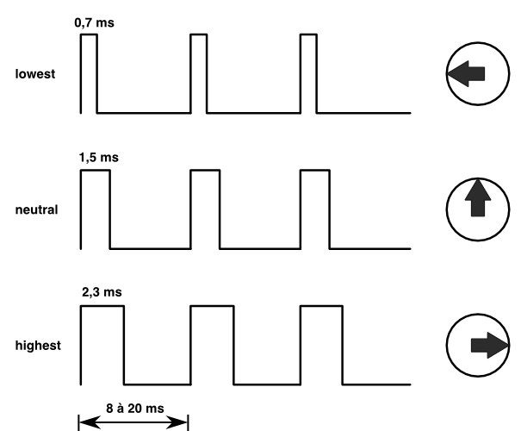
Controlling a servo with PWM
The position of the servo is changed by sending pulses of different width.
The servo looks at the pulsewidth and turns as desired.
The servo gets power separately.
With a servo, the pulse width modulation is not controlling the amount of energy fed to the servo
With a servo, pulse width modulation is rather a communication protocol.

Slide 29
Dimming a LED with PWM
Put the green LED in the right place.

Slide 30
More information
This presentation, source files of the game and workshop material
www.github.com and search for Weekendschool or for PiAndMore
scratchClient
http://heppg.de/ikg/wordpress/?page_id=6
Scratch
https://scratch.mit.edu/
Scratch on Raspberry Pi
https://www.raspberrypi.org/forums/viewforum.php?f=77
Raspberry Pi
https://www.raspberrypi.org/
Arduino
https://www.arduino.cc/

Slide 31
Start of the advance material – not worked out.

Slide 32
Add a Joystick
The joy stick consists of
Potentiometer for X
Potentiometer for Y
Button
Wire these 3 signals via a 1 kOhm resistor on the breadboard to pins A1 and A2 for X and Y and the button to one of the digital porst
Adapt the scratchClient config
Once it runs, you can see values for the potmeter as sensors in Scratch.

Slide 33
Add a Servo

Slide 34
Control a buzzer

Slide 35
Control a 3-color LED

Slide 36
Control multiple Arduinos

Slide 37
The counting function of scratchClient

Slide 38
Debouncing

